Slide 1
Angular Testing
9 - Visual Regression and Storybook
Notes:
Schwerer wirds nicht, dafür kann RxJS auch einiges
Komplexe RxJS kann aber nur mit Unit Tests testen
Man muss direkt an die Observables rankommen. Private Methoden oder so gehen nicht

Slide 2


Slide 3


Slide 4



Application Code
Test Specs
JSDom
@angular/testing

Slide 5



Frontend Application
2
Headless Browser
1
Test Specs
3
4

Slide 6

Main Challenges
Pixel Matching
Component Isolation

Slide 7
We want isolated Component Tests

Slide 8

Introducing Storybook
Notes:
Say that this is also comes from the family of tools that are uniquely applicable for various frameworks. Like Jest or Cypress afterwards

Slide 9
Frontend Application
2
Headless Browser
1
Test Specs
3
4

Slide 10
Storybook
2
Headless Browser
1
Test Specs
3
4
Application Code
(Components)

Slide 11
Storybook
Allows to isolate Components
Not Angular Specific
Configure a Component for various states
Can also used for visual widget library (not just testing)

Slide 12
Storybook Setup - "Module" Configuration - 1/3
export default {
title: 'Eternal/HolidayCard',
component: HolidayCardComponent,
decorators: [moduleMetadata({ imports: [MatButtonModule, MatCardModule] })],
argTypes: { holiday: { name: 'Holiday', description: 'JSON object for the Holiday' } }
} as Meta;

Slide 13
Storybook Setup - Template - 2/3
const Template: Story<HolidayCardComponent> = (args: HolidayCardComponent) => ({
component: HolidayCardComponent,
props: args
});

Slide 14
Storybook Setup - Variation - 3/3
export const Default = Template.bind({}); Default.args = { holiday: { id: 1, title: 'Holiday', description: 'A holiday', imageUrl: 'https://eternal-app.s3.eu-central-1.amazonaws.com/assets/AngkorWatSmall.jpg' } };

Slide 15
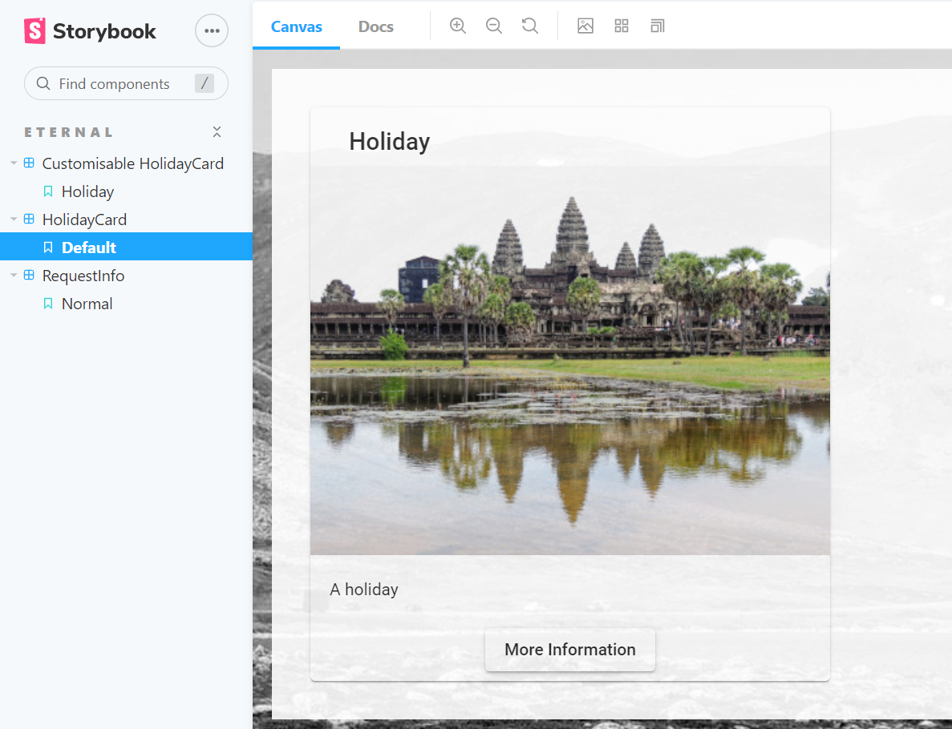

Slide 16
What about
Pixel Matching???

Slide 17
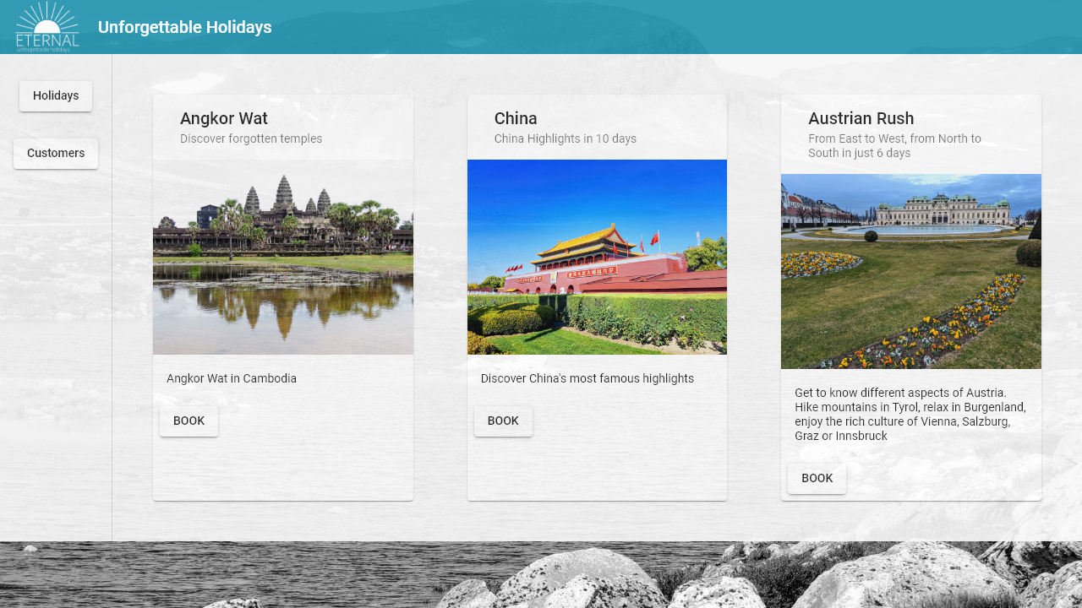

Spot the difference

Slide 18
Spot the difference

Slide 19
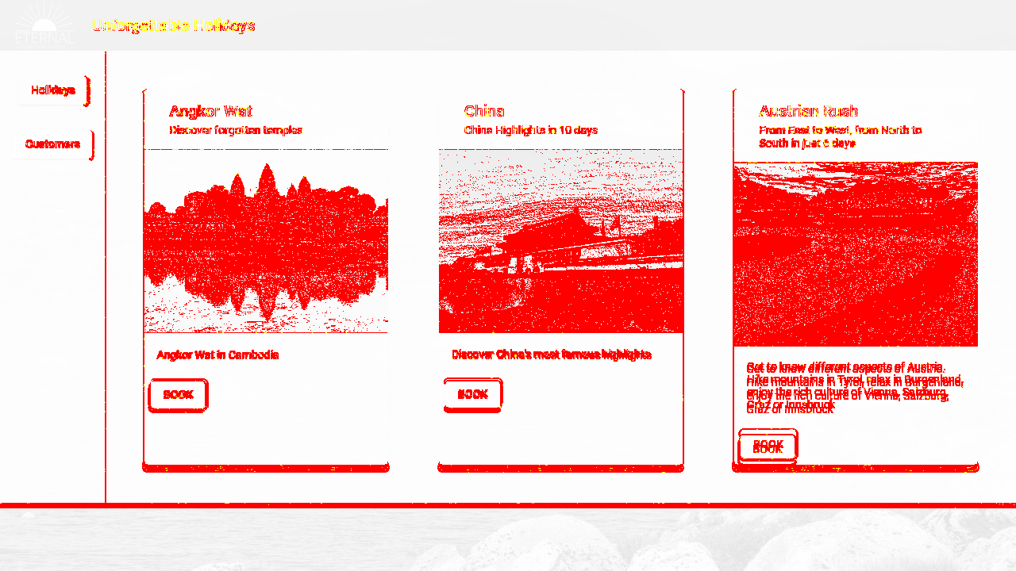

Slide 20


Storybook
2
Headless Browser
1
Tests
3
4
Code
(Components)

Slide 21

Storybook
2
Headless Browser
1
Test Specs
3
4
Application Code
(Components)

Slide 22



Cloudanbieter

Slide 23
Summary
Visuelle Regression is an important Testing Technique
Special Requirements for Infrastructure
Docker
Cloudprovider
Storybook for Componenttests and Widget Gallery
Testingtools:
Jest & Puppeteer
Playwright
Cypress

Slide 24

Lab Time

